Slide 1
IBM Attrition Analysis
Presented by-
Tanmay Upasani-WD26

Slide 2
Index
Introduction
What is the average age of employees being attrited?
What is the correlation between Age and Monthly income in this organisation?
Does gender affect the trend of attrition?
Has attrition affected one department more than others?
How does type of travel affect the attrition trend?
What are attrition trends in distance traveled from home?
How do attrition trends affect distance from home for different genders? And which department is affected the most?
How does work environment affect attrition?
How does marital status affect attrition for all genders? Does job satisfaction also play a part?
What is the correlation between Years spent in current role and monthly income?
Conclusions

Slide 3
Introduction
One of the most important asset of any organisation is it’s workforce.
It should come as no surprise about how much organisations invest in developing this asset.
However, during the course of their career many employees jump the ship and most of the times end up joining a rival.
This not only results in an urgent need for a like for like replacement but also leaves the organisation with a puzzle to solve “Why did they quit?”
In this presentation we try to assess the data at hand and try to come up with multiple possible answers to why did 16% employees of this particular organisation ended up leaving.

Slide 4
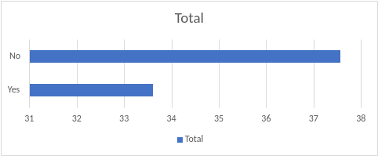
What is the average age of employees being attrited?
From the data that has been analysed it’s visible that the average age of employees being attrited is 33.60 yrs while that of those not attrited is 37.56 yrs.
One possible conclusion is that as the employees start going over the wrong side of the age of 35, they prefer a stable option and thus end up in the same organisation.
So there’s no incentive for a stable career in this organisation for employees below 35?

Slide 5
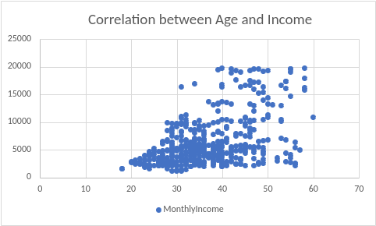
What is the correlation between Age and Monthly income in this organisation?
From the data analyzed it can be seen that there is a weak positive correlation between the two.
This translates to a weak relationship between Age and Monthly Income. Although both variables tend to go up in response to one another, the relationship is weak.
Young employees might want an assurance of hike in income with increase in their age, which could’ve been demonstrated by a strong positive correlation.

Slide 6
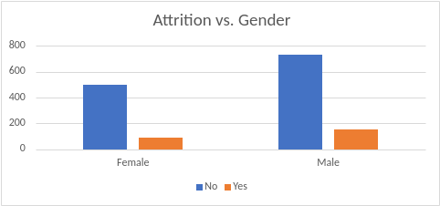
Does gender affect the trend of attrition?
Count of Gender | Attrition
Gender | No | Yes
Female | 40.63% | 36.71%
Male | 59.37% | 63.29%
Grand Total | 100.00% | 100.00%
From the analyzed data it can be seen that from the total number of employees undergoing attrition, 63.29% are male and 36.71% are females.
So it’s obvious that the male employees have been at a possible disadvantage which made them think twice about their choice of employer.

Slide 7
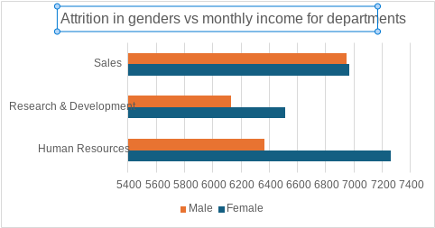
Looking at the available data:
Here it’s clearly visible that attrited males have the least monthly income in R&D department leading to a high rate of attrition.

Slide 8
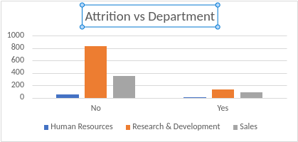
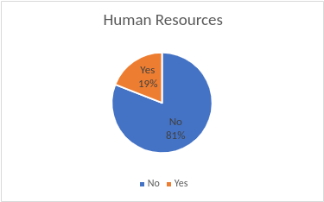
Has attrition affected one department more than others?
From the data analyzed it can be seen that the R&D department has bore the brunt of attrition.
From the total attrited employees 56.12% employees belonged to R&D; while 38.82% were from the Sales department and 4.29% worked in HR.

Slide 9
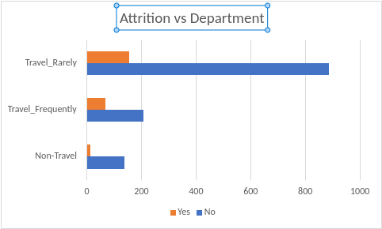
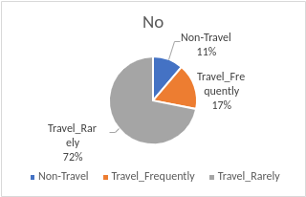
How does type of travel affect the attrition trend?
It can be inferred from the pivot table that of all the employees attrited, 65.82% travelled rarely for work related purposes.
29.11% travelled frequently while 5.06% didn’t travel at all for their work purposes.
This means there’s a clear lack of benefits for the employees who travel rarely and ended up quitting.

Slide 10
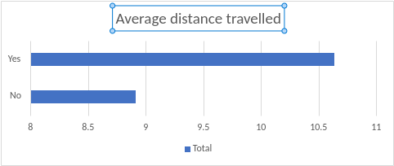
What are attrition trends in distance traveled from home?
From the analyzed data, it can be seen that the average distance travelled from home for work purposes is 10.63kms for attrited employees.
For non attrited employees the same is 8.91km.
While no particular conclusion is possible it can be seen that most employees would prefer to travel below 10km.

Slide 11
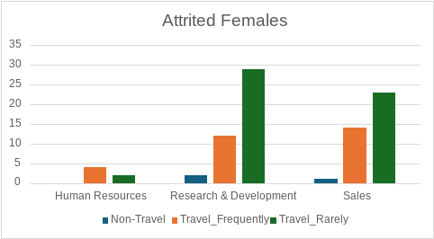
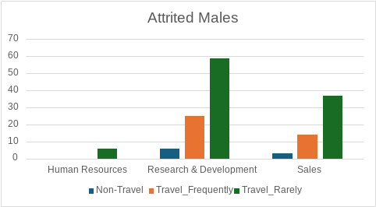
How do attrition trends affect distance from home for different genders? And which department is affected the most?
From the analyzed data it can be seen that for male employee attrition, a total of 59 employees belong to the travel rarely category and for females the same number stands at 29 in the same category. These totals form the majority of total attrition faced by all categories.
As far as the department is concerned, the trend that has been previously observed is carried forward as well. The R&D department faces the most attrition for both the genders.

Slide 12
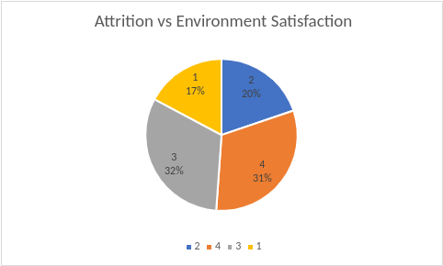
How does work environment affect attrition?
Assuming that 1 being not satisfied and 4 being most satisfied highest percentage of attrition can be found in lvl 1 while the least can be found in lvl 2.
While Lvl 3 and Lvl 4 have the highest percentage of non attrited employees.

Slide 13
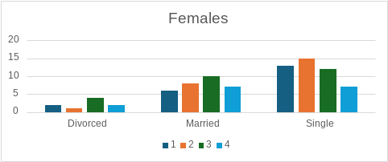
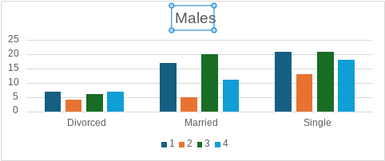
How does marital status affect attrition for all genders? Does job satisfaction also play a part?
For attrited female employees, the highest can be found in job satisfaction level 2 and are currently single. The total stands at 15.
However, for attrited male employees, the highest can be found in both satisfaction level 1 and lvl 3. There are 21 employees who are currently single and fall in both categories.
It can be concluded that for single employees, job satisfaction plays a bigger part in attrition as compared to other categories. This trend can be observed in both genders.

Slide 14
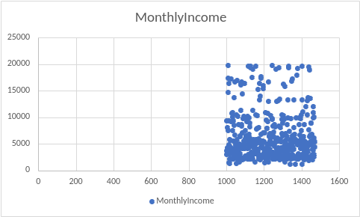
What is the correlation between Years spent in current role and monthly income?
From the analyzed data it can be observed that there’s a weak positive correlation between number of years spent in current role and monthly income.
Although it appears that as the years go by, monthly income increases as well. However, because it is weak, stagnation in one role for lower income is a real possibility.
And some employees might prefer a strong positive correlation for continuing the role.

Slide 15
Conclusion
Analysis of the available data concludes that attrition took place majorly among the male employees.
Causes of Attrition:
Distance needed to travel to work.
Job environment satisfaction.
Weak assurances of increased income despite spending major part of their careers in said role.
Lesser income in various departments affect the decision making.
Job Satisfaction in employees with different marital status affects decision making.
For any organization aiming to keep hold of their employees for long term, addressing the above factors could go a long way into improving the quality of the workforce with limited investments.

Slide 16
Appendix:
IBM Attrition Report
Bi-Variate Analysis Report
Multivariate Analysis Report

